Slide 1
The Giver Unit
Visual Walk
Resource 1.3

Slide 2
Picture 1

Slide 3
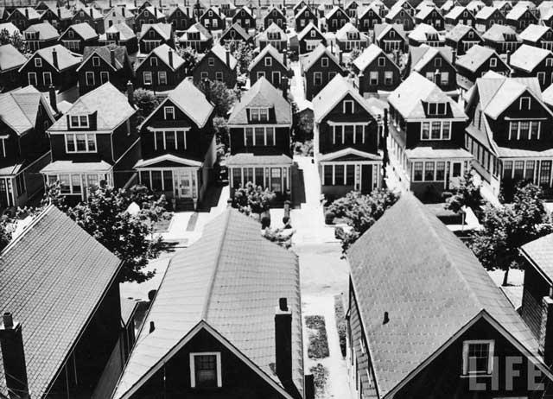
Picture 2

Slide 4
Picture 3

Slide 5
Picture 4

Slide 6
Picture 5

Slide 7
Picture 6

Slide 8
Picture 7

Slide 9
Picture 8

Slide 10
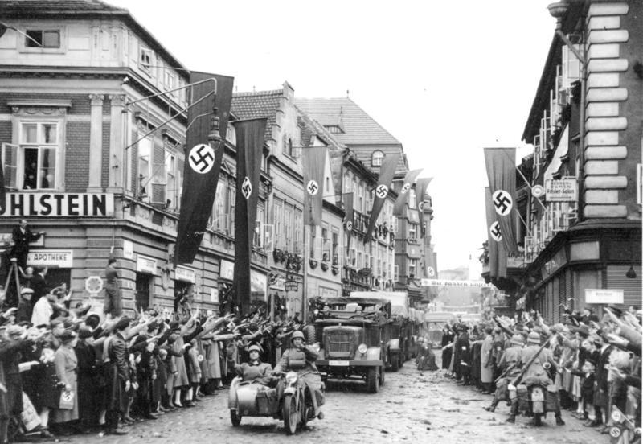
Picture 9

Slide 11
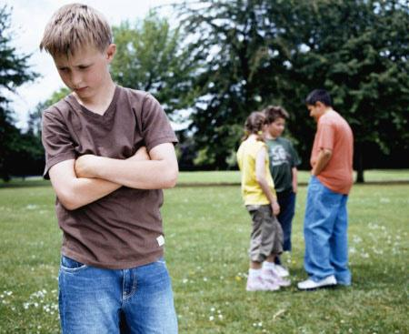
Picture 10

