Slide 1
Roll of Thunder, Hear My Cry By: Mildred Taylor

Slide 2
Anticipation Guide
Responding to the following statements.
Choose one statement and in your journal write a one paragraph response justifying why you agree or disagree with the statement.
When you are done staple the anticipation guide in your journal. We will be returning to these statements throughout the novel.

Slide 3
1. No child should have to use school books that are falling apart. | Agree ________ | Disagree _______
2. Helping a homeless person can be dangerous. | Agree ________ | Disagree _______
3. People from different races should be treated differently than people of your own race. | Agree ________ | Disagree _______
4. If you are kind to others, they will be kind to you. | Agree ________ | Disagree _______
5. If someone does something to you, it is okay to get even. | Agree ________ | Disagree _______
6. Discrimination and prejudice are the same thing. | Agree ________ | Disagree _______
7. If you live a good life, good things will happen to you. | Agree ________ | Disagree _______
8. Honesty is always the best policy. | Agree ________ | Disagree _______
9. Sometimes it is okay to do something just because everyone else is doing it. | Agree ________ | Disagree _______
10. It is foolish to risk all that one owns for the goodness of others. | Agree ________ | Disagree _______
11. It would be better to stay home than to walk a great distance to and from school each day. | Agree ________ | Disagree _______
12. If you allow someone to mistreat you then you have no self-respect | Agree ________ | Disagree _______

Slide 4
Based on the following images what do you think life was like in the South in the 1930? Record your answer in your journal under your paragraph response to the anticipation guide.

Slide 5
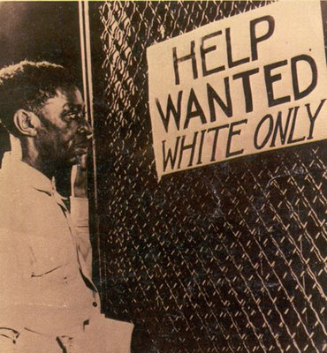
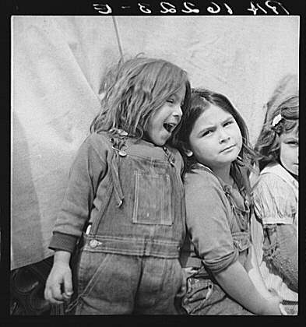
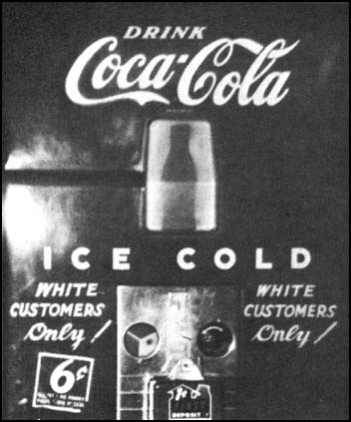
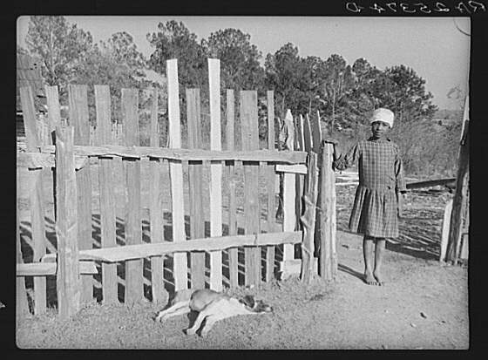
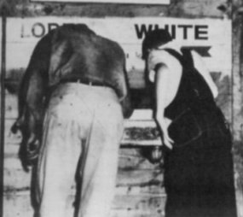
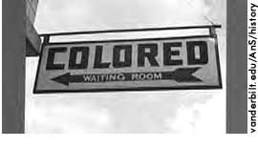

Slide 6
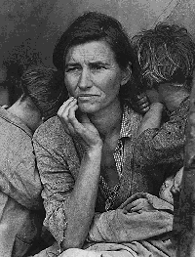
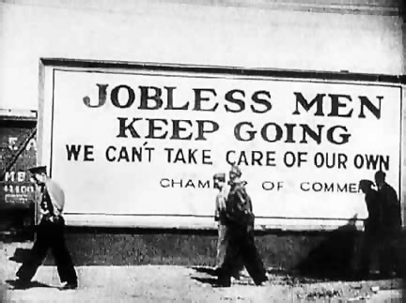
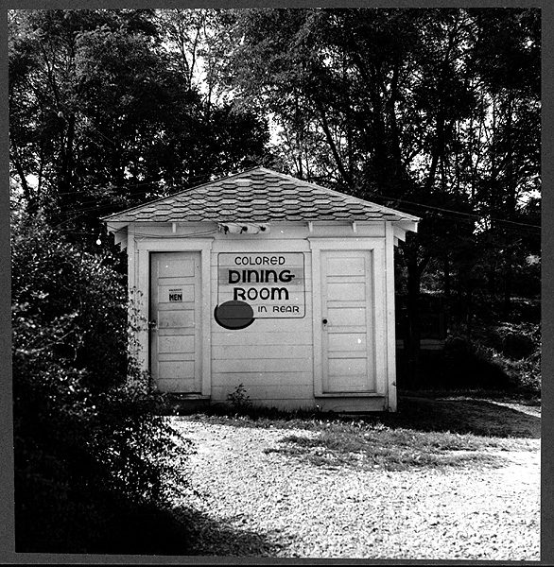
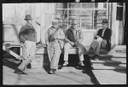
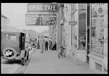

Slide 7
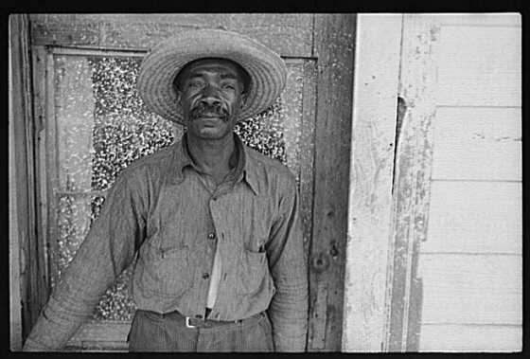
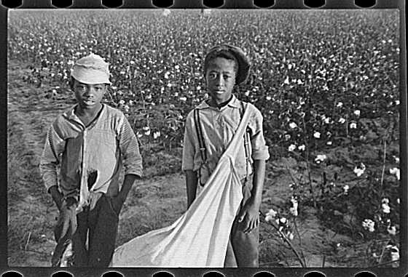
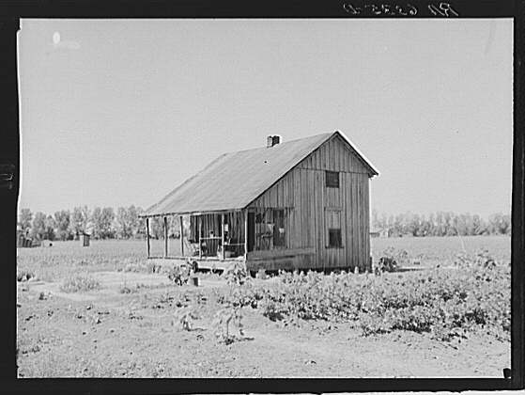
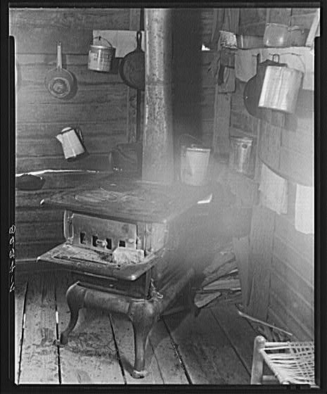
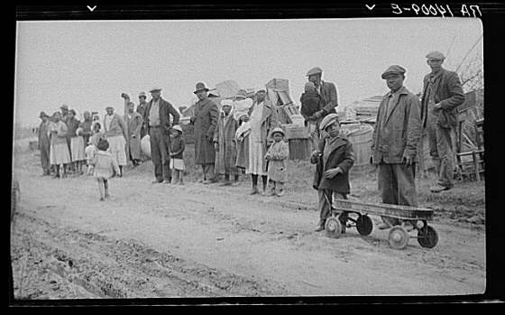

Slide 8
Roll of Thunder Hear my Cry Synopsis
The story takes place in 1933, during the height of the Great Depression.
Since the story occurs considerably before the Civil Rights Movement, rampant racial inequality is very much a reality, especially in the South.
However, some things are starting to shift—more African Americans are receiving an education and working decent jobs.
Although these changes provide hope, many white people feel threatened by this progress and turn to violence and aggression to control African Americans.

Slide 9
Setting 1933 Mississippi
U.S. undergoing The Great Depression
Segregation of Whites and Minorities/ Jim Crow Laws
The South was still mainly rural.
Many black families were sharecroppers.
Racial prejudice and hatred / “Nightriders” or “Ku Klux Klan”
Next

Slide 10
Ku Klux Klan
White supremacy organization
Terrorized blacks and anyone sympathetic to helping blacks gain equality.
Responsible for lynching, murders, torture, etc.
Back

Slide 11
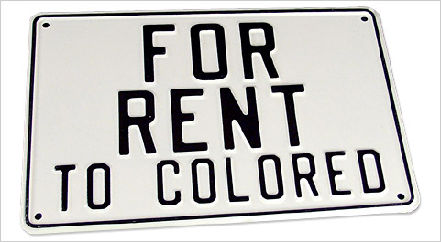
Jim Crow Laws
Designed to prevent Black citizens from achieving equality.
“It shall be unlawful for a negro and white person to play together or in company with each other in any game of cards or dice, dominoes or checkers.” —Birmingham, Alabama, 1930
“Marriages are void when one party is a white person and the other is possessed of one-eighth or more negro, Japanese, or Chinese blood.” —Nebraska, 1911
“Separate free schools shall be established for the education of children of African descent; and it shall be unlawful for any colored child to attend any white school, or any white child to attend a colored school.” —Missouri, 1929
Back

Slide 12
Sharecropping
The sharecropper was a freed slave, poor black, or poor white who owned no land after the Civil War.
Agreed to work a parcel of land owned by someone else, with the "rent" in the form of a share of the crop at harvest time.
Owner provided the land, seed, and tools, and claimed perhaps half the crop.
Often, the sharecropper ended up in constant debt, and in a situation not much better than slavery.
Back

Slide 13
Main Character
Cassie Logan
nine-year-old narrator of story.
Family is one of few black families to own land.
Doesn’t understand racism and why she is treated unfairly.

Slide 14
Themes
The importance of family
The importance of land
The importance of self-respect and respect of others

