Slide 1
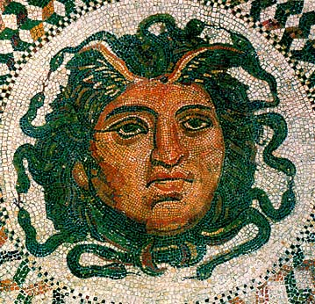
What patterns exist in myths?
From http://members.bib-arch.org

Slide 2
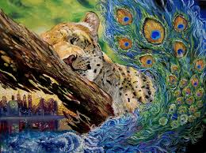
Natural Elements
Explanation: Elements found in nature are often used symbolically in myths.
From http://minhquach94.deviantart.com/art/Piece-11-Symbols-of-Nature

Slide 3
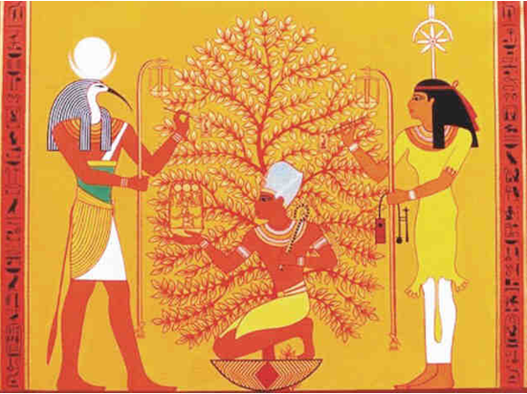
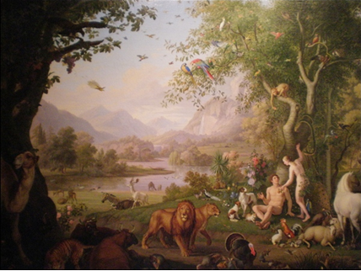
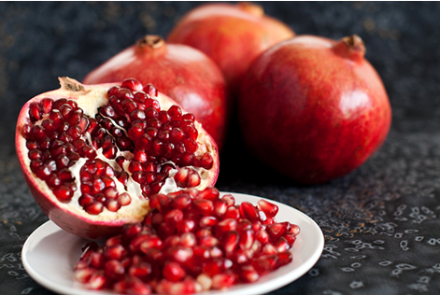
Natural Elements
Examples: Earth – mother, creation, life, knowledge, nourishment
Trees
From www.landofpyramids.org
From www.manataka.org
Gardens, forests
Seeds, fruit
From userealbutter.com

Slide 4
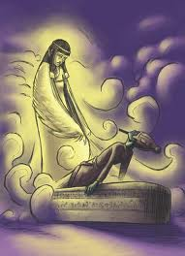
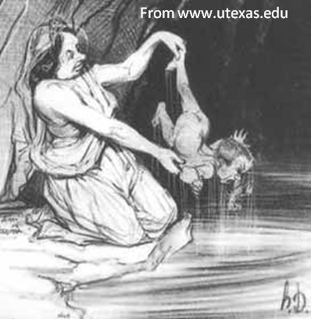
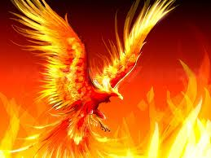
Natural Elements
More examples: Water – cleansing, mystery, life Fire (sun) – change, purification Air/wind – breath, life, holy spirit
A phoenix dies, turns to ashes, and is reborn in fire
From smokeslair.com
Isis blowing life back into her dead husband, Osiris
From religionnerd.com
Thetis dipping her son Achilles
into the River Styx

Slide 5

Natural Elements
Turn and talk: Where have you seen it?

Slide 6
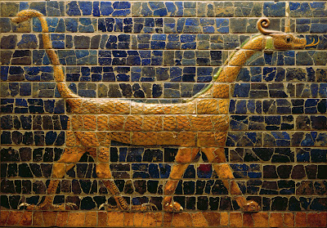
Animals
Explanation: In myths, animals can represent human qualities, distractions, or desires. The animals used vary depending on the culture.
From http://muddycolors.blogspot.com

Slide 7
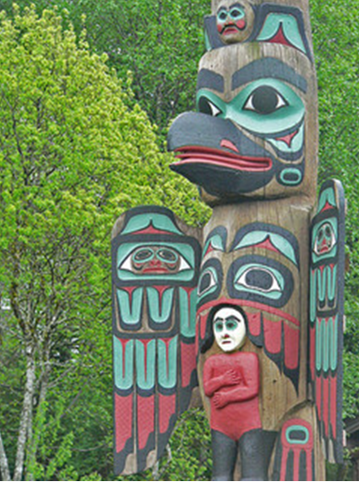
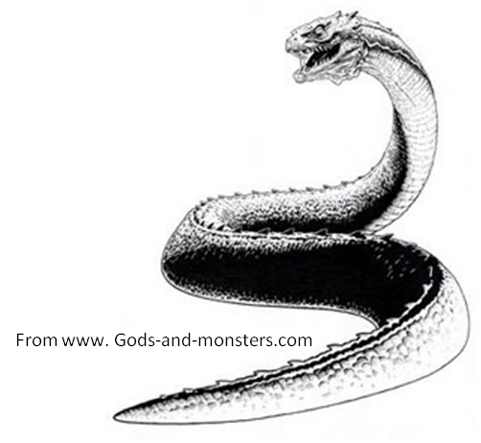
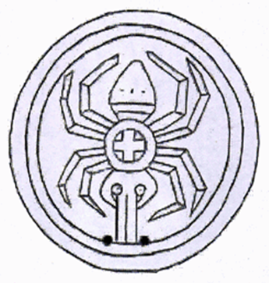
Animals
Examples: Serpent – evil, mystery, wisdom Spiders & their webs – weaving fate, creation, evil Birds – power, freedom, link to the gods, death, peace, creation
From www.museum.state.il.us
From www. flickr.com/photos/mharrsch

Slide 8
Animals
Turn and talk: Where have you seen it?

Slide 9
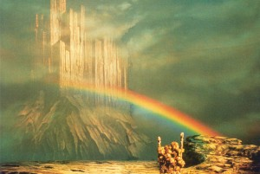
Colors
Explanation: Colors are often used symbolically in myths.
From http://norse-mythology.org

Slide 10
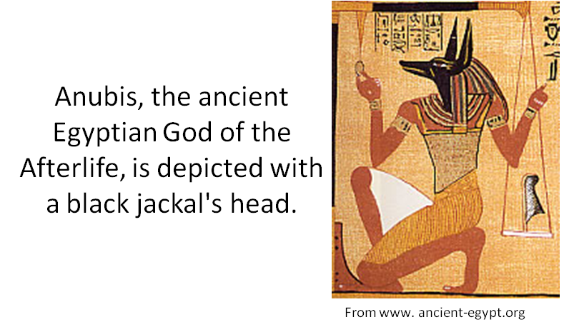
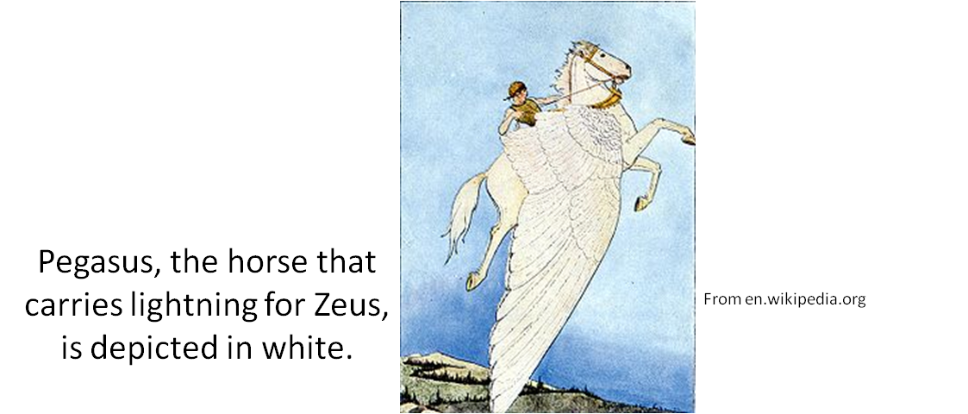
Colors
Examples: Black – chaos, mystery, death, evil White – purity, innocence, supernatural, spiritual

Slide 11
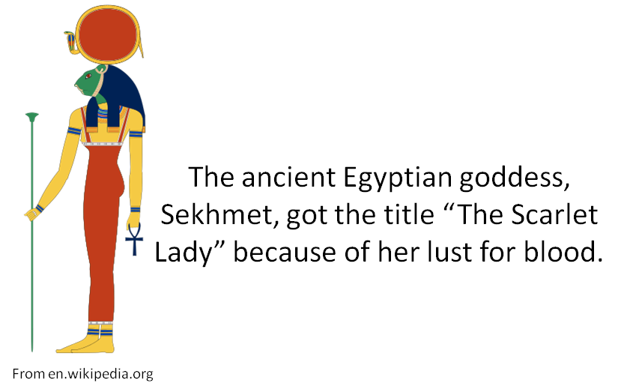
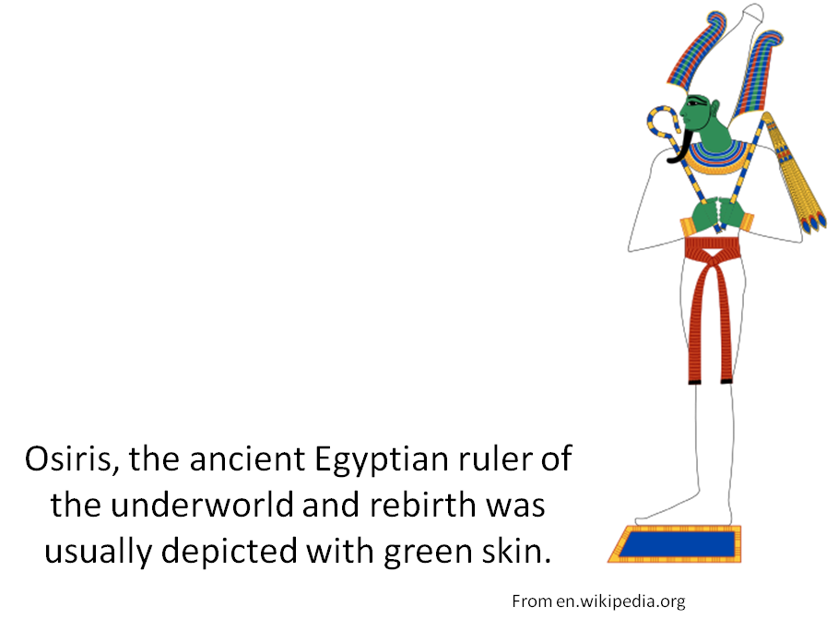
Colors
More examples: Red – blood, sacrifice, violent passion Green – growth and fertility OR death & decay

Slide 12
Colors
Turn and talk: Where have you seen it?

Slide 13
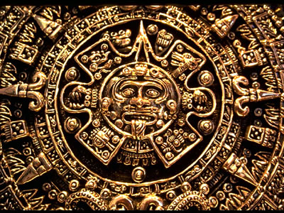
Circles
Explanation: Circles are often used in myths to represent cycles, unity, and life.
From http://www.windows2universe.org

Slide 14
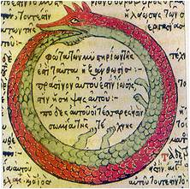
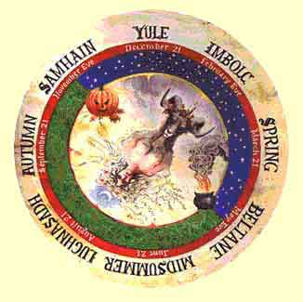
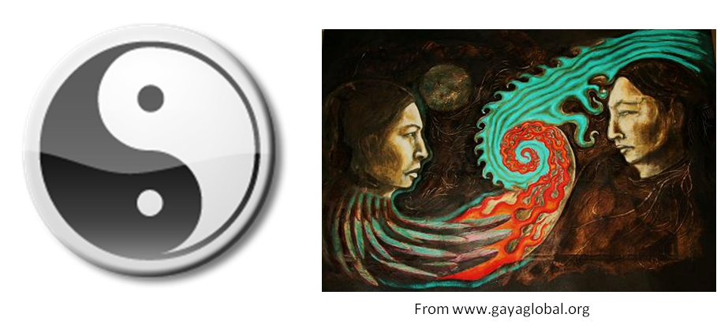
Circles
From en.wikipedia.org
Examples: Seasons – occur in a cycle Yin & Yang – represent duality and unity Life – often depicted as a continuous cycle of death and rebirth
From http://www.morning-earth.org

Slide 15
Circles
Turn and talk: Where have you seen it?

Slide 16
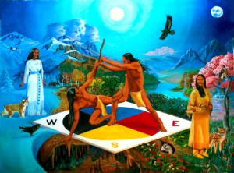
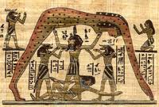
Creation
Explanation: Creation myths explain why things exist or why things are the way they are.
From www.englisharticles.info
From www.eso-garden.com

Slide 17
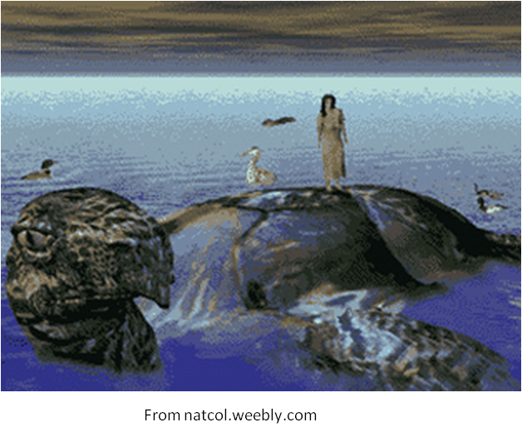
Creation
Example: “The World on Turtle’s Back” in an Iroquois myth describes how the Earth was grown on a turtle’s back.

Slide 18
Creation
Turn and talk: Where have you seen it?

Slide 19
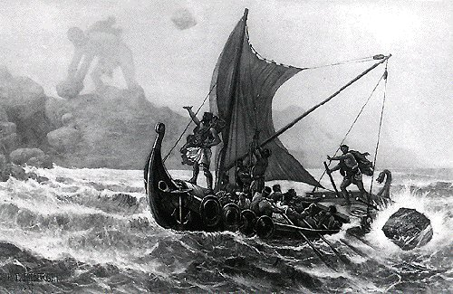
Heroes
Explanation: Mythological heroes complete a difficult task despite temptations and receive a reward upon completion.
From http://www.artofmanliness.com

Slide 20
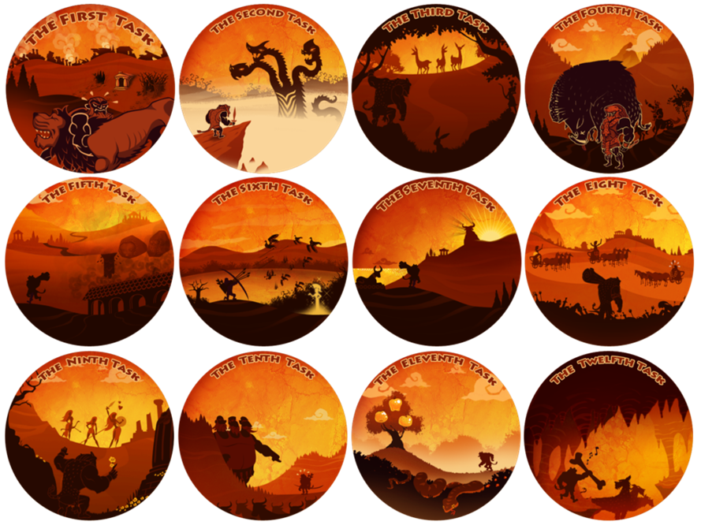
Heroes
Example: Hercules faced 12 labors which included battling several beasts. Upon completion, he was awarded immortality.
From pics4.this-pic.com

Slide 21
Heroes
Turn and talk: Where have you seen it?

Slide 22
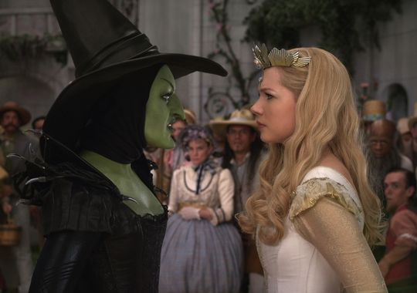
Females
Explanation: Normally, the female archetype takes one of two forms: Good or Evil
From http://wwwusatoday.com

Slide 23
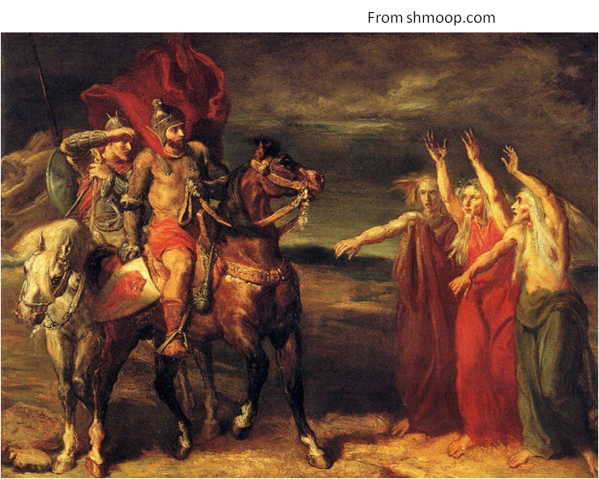
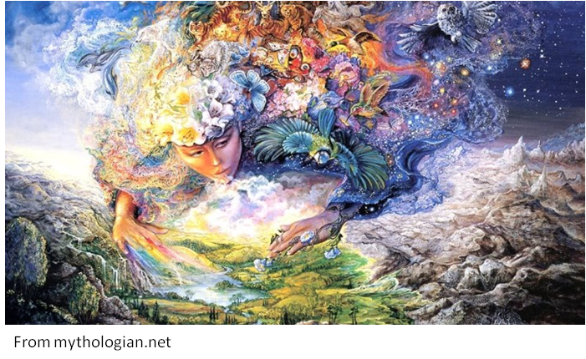
Females
Examples: Good – mother, beautiful, protection, life Evil – witches, sirens, spinners/weavers, ugly, danger, death

Slide 24
Females
Turn and talk: Where have you seen it?
End of presentation

