Slide 1
LORD OF THE FLIES
By William Golding

Slide 2
Look at the pictures and write down what you think is occurring? Why do you think these events occurring? Did something happen during this time? What?

Slide 3
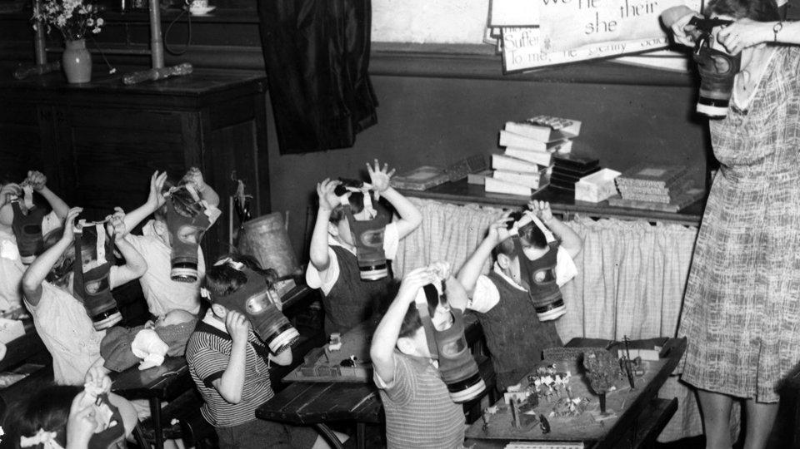
Image 1

Slide 4
Gas Masks
Gas masks were issued to all everyone young and old at the start of World War Two.
There was a very real fear in Britain that Nazi German Bombers would drop poison gas bombs on Towns and Cities as they had previously done in the Spanish Civil War a few years earlier.
An advisor to the government - Liddell Hart - told the Government to expect 250,000 deaths in the first week of the war alone.
Gas had been used a great deal in the. It was almost odorless (could not be smelt easily) and took 12 hours to take effect. It was so powerful that only small amounts needed to be added to weapons like high explosive shells to have devastating effects.
The masks were made of black rubber, which was very hot and smelly and It was difficult to breathe when you were wearing a gas mask. When you breathed in the air was sucked through the filter to take out the gas. When you breathed out the whole mask was pushed away from your face to let the air out.

Slide 5
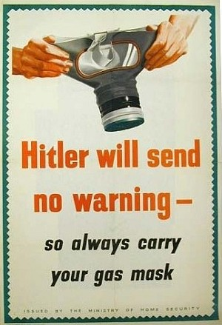
Posters reminded people to carry their gas mask at all times. People were fined if they were caught without their GasMasks

Slide 6
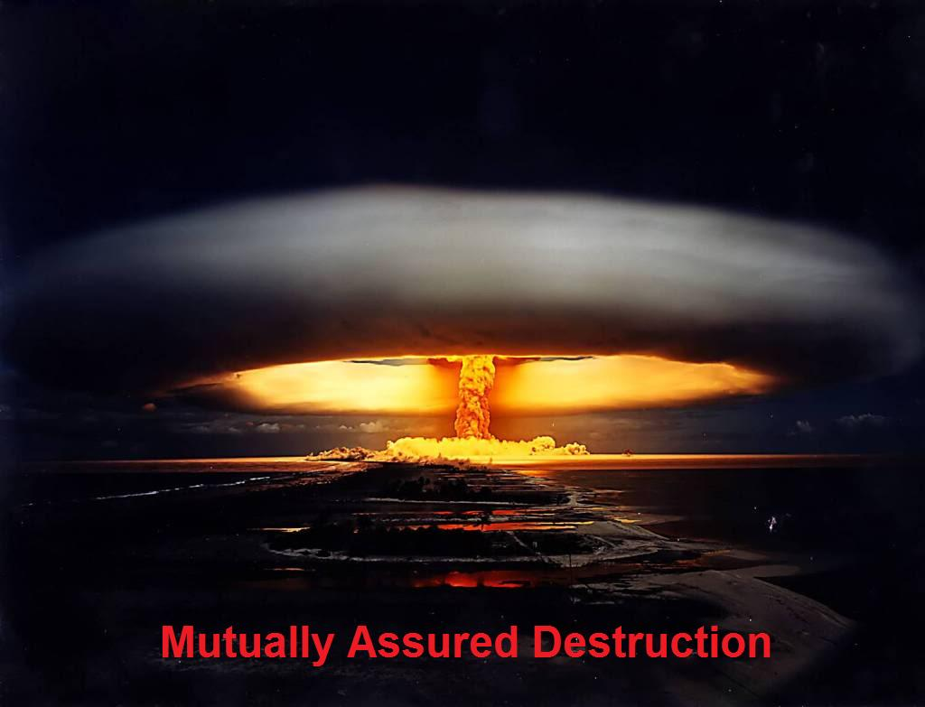
Image 2

Slide 7
Mutually Assured Destruction
military strategy and national security policy in which a full-scale use of nuclear weapons by two or more opposing sides would cause the complete annihilation of both the attacker and the defender.
In the event of an attack from an aggressor, a state would massively retaliate by using a force disproportionate to the size of the attack

Slide 8
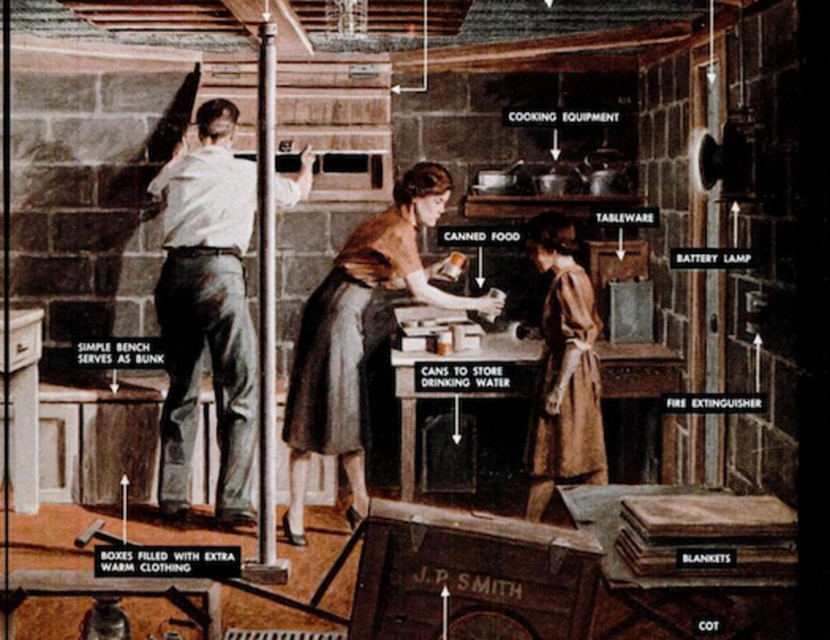
Image 3

Slide 9
Family Foxhole: March, 1951
"You cannot escape an atomic bomb, but there is something practical and patriotic you can do to prepare for atomic attack. A millionaire could not construct a complete A-bomb-proof shelter, but the average house-holder can make a worthwhile refuge room in the average basement. By building your family foxhole, you will also be building the state of mind that can resist the pressures of aggression as well as the shocks of actual atomic war.“
President John F. Kennedy appointed America's first civil defense chief for nuclear war preparedness in 1961, during the height of the Berlin Crisis. Steuart Pittman, a lawyer, was tasked with building enough fallout shelters to protect everyone in the U.S. in the event of an atomic attack. Three years later, Pittman resigned the position--which he described as one of the most "unappetizing, unappealing and unpopular" jobs ever created--after bitter debates over the ethics, feasibility, and cost of the program.

Slide 10
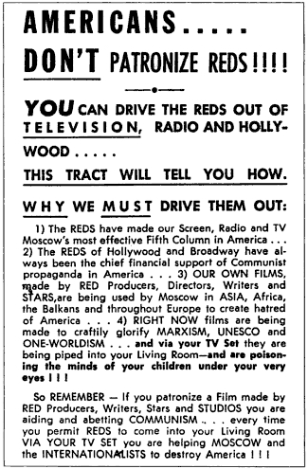
Image 4

Slide 11
Background Information

Slide 12
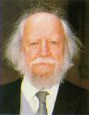
L.O.T.F Author
William Golding
Born in Britain
1911-1993

Slide 13
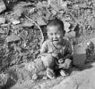
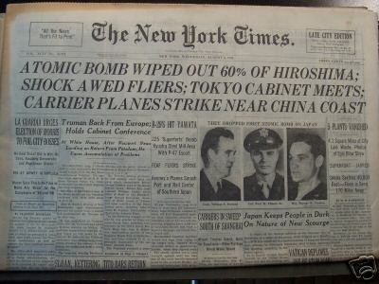
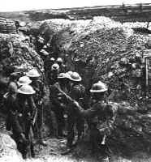
As a child, Golding had witnessed WWI, which was referred to as “the war to end all wars”
HOWEVER, 22 years later Britain was again involved in ANOTHER WAR to end all wars, which caused more devastation than was imaginable

Slide 14
Lord of the Flies Historical Context
Britain declared war on Germany on 3 September 1939 and the war in Europe lasted for almost six years.
In the novel Golding explores some of the ideas that lay behind the Nazi government of Germany. The German leader Adolf Hitler adapted ideas from science and philosophy for his own ends.
Millions of ordinary Germans were involved in the war and some carried out terrible atrocities. You may find parallels for this in the novel.

Slide 15
During the Second World War, William Golding served in the British Navy, on several different ships, and was in charge of specially adapted landing craft for the D-day landings in Normandy, so he witnessed at first hand the horrors of war.
He came to the conclusion that human beings are not naturally kind and that even children are capable of incredible cruelty if the circumstances demand or even simply allow it.
Golding was interested in the way that violence can develop from innocent beginnings.

