Slide 1
Poetry Unit
Introduction

Slide 2
Day 1

Slide 3
Poetry Forms
Poems come in a variety of forms, but they are usually talked about in terms of two categories:
Traditional Form
Organic Form
Form: a poem’s structure, or the way the words are arranged on the page.
Lines: All poems are made up of series of lines. The length of the lines, where they break, and how they are punctuated all contribute to a poem’s rhythm and meaning.
Stanza(s): Many poems, the lines are grouped into stanzas, which function like paragraphs.

Slide 4
Traditional Poetry
Surgeons must be very careful
When they take the knife!
Underneath their fine incisions
Stirs the Culprit—Life!
— by Emily Dickinson
This is an example of a traditional poem.
Traditional poems are popular because of their regular, predictable rhythm and rhyme.
Other forms of traditional poetry also follow “rules.”

Slide 5
Traditional Poetry
Characteristics
• follows fixed rules, such as a specified number of lines
• has a regular pattern of rhythm and/or rhyme
Examples of Traditional Forms
Epic: a long narrative poem; examples: Homer’s Odyssey.
Ode: a meditative or commemoratice lyric Poem.
Ballad: a narrative poem written to be sung or recited.
Sonnet: a 14-line having a set pattern of rhythm and rhyme; example shakespears sonnets.
Haiku: a form of Japanese poetry having a set number of lines and syllables.
Limerick: a lightor humorous poem with a particular rhyme scheme.

Slide 6
Organic Poetry
we’re everyanything more than believe
(with a spin
leap
alive we’re alive)
we’re wonderful one times one
— from “If Everything Happens That Can’t Be Done” by E. E. Cummings
This is an example of an Organic Poem.
Organic Poetry Is unpredictable; it does not follow the rules of traditional poetry.

Slide 7
Organic Poetry
Characteristics
does not follow established rules for form
does not have a regular pattern of rhythm and may not rhyme at all
may use unconventional spelling, punctuation, and grammar
Examples of Organic Forms
Free Verse: poetry that does not have a regular meter
Concrete Poetry: conveys meaning visually through the arrangement of letters and words.

Slide 8
Traditional Form
For centuries, poets have written sonnets that explore everything from unanswered love to the mysteries of nature.
There are several types of sonnets, but all of them have 14 lines and are written in a strict pattern of rhythm and rhyme.
Read this poem, which is a Petrarchan sonnet, to determine the characteristics of this particular form.

Slide 9
Pretty Words Poem by Elinor Wylie
Traditional Form
Poets make pets of pretty, docile words: I love smooth words, like gold-enamelled fish Which circle slowly with a silken swish, And tender ones, like downy-feathred birds: Words shy and dappled, deep-eyed deer in herds, Come to my hand, and playful if I wish, Or purring softly at a silver dish, Blue Persian kittens fed on cream and curds. I love bright words, words up and singing early; Words that are luminous in the dark, and sing; Warm lazy words, white cattle under trees; I love words opalescent, cool, and pearly, Like midsummer moths, and honied words like bees, Gilded and sticky, with a little sting.
How many lines make up the first stanza?
How many are in the second stanza?
In the first stanza, each group of end-rhyming words is highlighted in the same color. Identify the end-rhyming words in the second stanza.
Compare the ideas expressed in the first stanza with those in the second one

Slide 10
Beware: Do not Read This Poem By Ishmael Reed
Organic Form
the hunger of this poem is legendary
it has taken in many victims
back off from this poem
it has drawn in yr feet
back off from this poem
it has drawn in yr legs
back off from this poem
Identify three characteristics that make this poem unconventional.
Even though the poet does not use punctuation, this poem has a natural rhythm.
Read the poem aloud, using the rhythm you think is appropriate.
Poems written in free verse, like the one shown, do not adhere to a regular pattern of rhythm and rhyme.

Slide 11
Practice
For the next 10 minutes you are to write a free verse poem about a person you admire.

Slide 12
Poetic Elements
Like music, language has rhythm.
In poetry, the pattern of stressed and unstressed syllables in each line is what creates the rhythm.
Rhyme also enhances the musical quality of a poem. It can occur at the ends of lines as end rhyme or within lines as internal rhyme.
A regular pattern of rhythm is called a meter.
A regular pattern of rhyme is called a rhyme scheme.
Meter is charted in a process called scansion, where stressed syllables are marked with a ' and unstressed syllables with a ∪.
A rhyme scheme is charted by assigning a letter of the alphabet to matching end rhymes.
Notice how the meter and rhyme scheme are marked in these lines from “A Birthday” by Christina Rossetti:
Notes:
For a poet, deciding on a subject and form is just the beginning. Will the poem hum along at a steady beat or charge ahead with a bold rhythm? What images or sounds will convey a mood? Using sound devices and language, poets can convey meaning, make music, and tap into the senses.

Slide 13
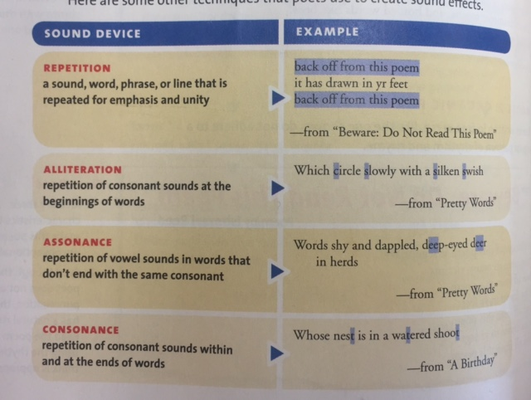
Here are some other techniques that poets use to create sound effects.

Slide 14
Remember
Poems are written in lines rather than sentences, and poets tend to convey their ideas and feelings through strong images and words
Poetry, prose and songs all use rhyme, rhythm, and sound devices- but to different degrees
A poet might use alliteration and assonance to convey a particular mood or to establish a distinct tone.
A speechwriter might use repetition and rhythm to stress certain persuasive points.
A song writer might use alliteration to create a memorable phrase or lyric.

Slide 15
Now that you have an idea take a minute to answer: What is poetry?
Poetry is a form of literary expression that captures intense experiences or creative perceptions of the world in a musical language.
Poetry is not prose. Prose is the ordinary language people use in speaking or writing
By looking at the set up of a poem, you can see the difference between prose and poetry.
Basically, if prose is like talking, poetry is like singing.

Slide 16
M E T E R
To identify a poem’s meter, you have to break each line into smaller units, called feet.
A foot consists of one stressed syllable and one or two unstressed ones.
Look at the type and the number of feet in each line. Then combine the terms listed on the side— for example, trochaic trimeter or iambic pentameter— to describe what you find. Scan this poem to determine its meter.
Some say the world w ill end in fire,
Some say in ice.
From what I’ve tasted of desire
I hold with those who favor fire
But if it had to perish twice,
I think I know enough of hate
To say that for destruction ice
Is also great
And would suffice.
What is the metrical pattern of the blue lines?
What is the poems rhyme scheme?

Slide 17
Other Sound Devices
Edgar Allan Poe wrote “The Bells” to experiment with the musical qualities of language. Read this excerpt aloud to get the full impact.
Hear the sledges with the bells--
Silver bells!
What a world of merriment their melody foretells!
How they tinkle, tinkle, tinkle,
In the icy air of night!
While the stars that oversprinkle
All the heavens, seem to twinkle
With a crystalline delight;
Keeping time, time, time,
In a sort of Runic rhyme,
Identify four examples of sound devices used in this poem.
What effects do these sound devices create?
Explain how they add to Poe’s description of the bells.

Slide 18
Im a g e r y a n d F ig u r a t iv e La n g u a g e
Poets also use sensory details to illustrate and elaborate on their ideas and feelings.
For example, if we look again at “Fire and Ice” we see that Robert Frost uses two powerful sensory details— fire and ice— to help us picture the end of the world. Not only can we probably visualize the world engulfed in flames or numbed by ice, but we can also probably imagine what each type of destruction would feel like. These details are enough to spark unsettling images in your mind.
Like imagery, figurative language opens up the mind to more than the literal meanings of words. In this example, notice how the figurative expression not only is more descriptive but also conveys a stronger emotion:
Literal: He was angry.
Figurative: He burned with anger.
Notes:
Unlike prose, poetry is very concise: a limited number of words must carry a great deal of meaning. One of the ways poets expand their ability to make meaning is by using imagery and figurative language. You’ve already learned how imagery in fiction evokes sensory experiences for readers by appealing to the five senses

Slide 19
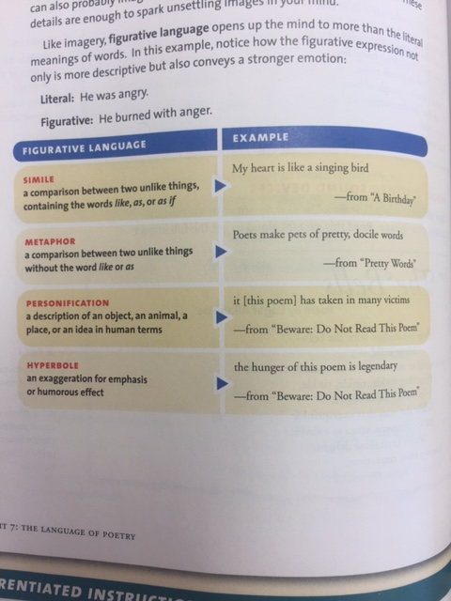
Im a g e r y a n d F ig u r a t iv e La n g u a g e

Slide 20
As you read this next poem, notice the contrasting images of Miss Rosie— what she was and what she has become. Also, pay attention to the poem’s speaker, the voice that describes the character. How does the speaker's impression of Miss Rosie affect your perception of her?
miss rosie
by Lucille Clifton
when i watch you
wrapped up like garbage
sitting, surrounded by the smell
of too old potato peels
or
when i watch you
in your old man’s shoes
with the little toe cut out
sitting, waiting for your mind
like next week’s grocery
i say
when i watch you
you wet brown bag of a woman
who used to be the best looking gal in georgia
used to be called the Georgia Rose
i stand up
through your destruction
i stand up
Point out three unusual comparisons and identify them as similes or metaphors. What image of Miss Rosie does this figurative language convey?
Find the hyperbole and explain its effect.
Reread the blue lines. What is the speaker’s attitude toward Miss Rosie? Explain how it affects your impression of Miss Rosie.
Notes:
In this poem, the writer uses sensory details and figurative language to acquaint you with a vivid character.

Slide 21
Analyze the Literature
First poem is a Shakespearean sonnet, which has a rhyme scheme and organization different from.
A Shakespearean sonnet consists of three quatrains, or four-line units, and a final couplet, or pair of rhyming lines.
Read the sonnet aloud first to understand what it is saying.
Then read it again to analyze its poetic elements. What techniques are used to complement and extend the poem’s meaning?
Notes:
Now that you’ve learned about poetic forms and techniques, you’re ready to see how everything works together in two distinctly different love poems.

Slide 22
Not in a silver casket…
By edna St. Vincent Millay
Not in a silver casket cool with pearls
Or rich with red corundum or with blue,
Locked, and the key withheld, as other girls
Have given their loves, I give m y love to you;
Not in a lovers’-knot, not in a ring
Worked in such fashion, and the legend plain—
Semper fidelis, where a secret spring
Kennels a drop of mischief for the brain:
Love in the open hand, no thing but that,
Ungemmed, unhidden, wishing not to hurt,
As one should bring you cowslips in a hat
Swung from the hand, or apples in her skirt,
I bring you, calling out as children do:
“Look what I have!— And these are all for you.”
corundum: an extremely hard mineral, red and blue form of which are rubies and sapphires.
Semper fidelis Latin: always faithful.
cowslips: plants that have fragrant yellow flowers.
Identify the rhyme scheme of the poem.
This poem is written in iambic pentameter. Find and scan two lines that reflect this meter. Then find two lines that vary from the pattern. What is the effect of the change in rhythm?
How do the images in lines 1-8 contrast with those in lines 9-12?

