Slide 1
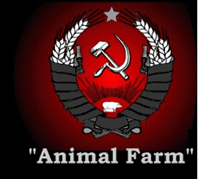
Animal Farm
Chapter 8

Slide 2
Chapter 8—Summary
No kill commandment is changed to:
“No animal shall kill any other animal without cause.”
Alcohol Commandment Changed to:
“No animal shall drink alcohol to excess.”

Slide 3
Pinchfield Farm
Stories of animal torture on Pinchfield Farm (Frederick’s farm) –Germany
Flogging old horse to death
Starved cows
Threw an old dog into the furnace
What does this symbolize?
Annihilation of the Jews during WWII

Slide 4
Allegorical Connections #1
1939: The Nazi-Soviet Non-Aggression Pact
A secret agreement between Stalin and Hitler
Guaranteed that neither country would oppose or attack the other

Slide 5
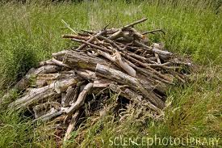
Allegorical Connections
Napoleon agrees to sell a pile of timber to Mr. Frederick of Pinchfield Farm
It was a show of cooperation and teamwork
Frederick violated
the animals’ trust

Slide 6
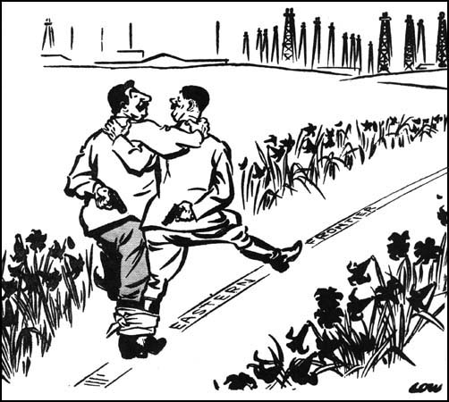

Slide 7
Allegorical Connections #2
1941: Hitler begins “Operation Barbarossa”
Germany attacks Russia at Stalingrad and elsewhere
In defiance of the Non-Aggression Treaty
Hitler moves into Russia but is forced to retreat

Slide 8
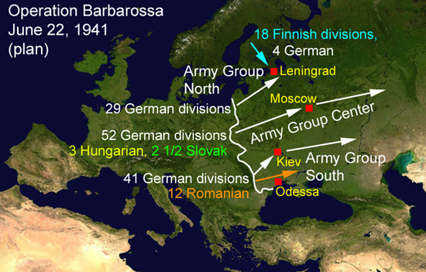

Slide 9
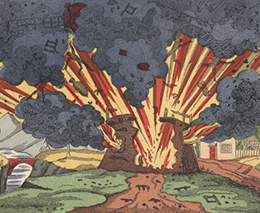
Allegorical Connections
The Battle of the Windmill
Frederick and his men invade Animal Farm
They blow up the windmill
Many animals are killed
Boxer is wounded

Slide 10
Emerging Themes
Be careful what you wish for
The animals wished to be freed from Jones’ poor leadership
Ended up in a worse position than before

